Slide 1



TSINGHUA UNIVERSITY
Files to Knowledge Database
TSINGHUA UNIVERSITY
Jiang Zhicheng Wang Zehua Zhao Hanhong

Slide 2


01
Why “knowledge database” ?
Do you have the experience of :
remembering something you must have read it somewhere within several days …
The material is on your computer, but you just cannot find it?
$Use LLM to have a better data remembering and management$!
Notes:
In the digital age, we are surrounded by an ever-increasing amount of information, from research papers to digital documents, and from online articles to video transcripts.
As the volume of data grows exponentially, the challenge of managing and extracting meaningful insights from this wealth of information becomes increasingly daunting. Traditional knowledge management methods, such as manual categorization and keyword-based searches, are no longer sufficient to meet our needs for efficiency and accuracy.
For example, have you had the experience of remembering something you must have read it somewhere within several days on your computer, bust just cannot find it?

Slide 3

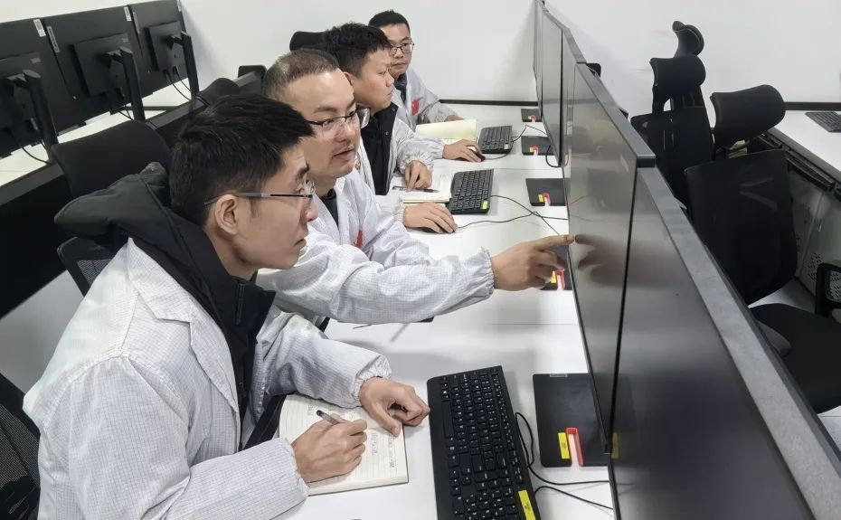
01
Our Goal
Reduce time wasting in searching materials
Construct a database for their knowledge
Discover new connections between topics
Notes:
In the modern educational landscape, students are often overwhelmed by the sheer volume of information available to them. This abundance of resources, while potentially beneficial, can also lead to a significant amount of time wasted on searching for the most relevant and accurate materials. To address this issue, constructing a comprehensive database tailored to their academic needs can be an invaluable tool for students.
This database would serve as a centralized hub of knowledge, organizing information by subject, topic, and subcategory, allowing students to quickly and efficiently access the materials they need. By reducing the time spent searching, students can allocate more of their valuable study time to comprehension and retention. This not only streamlines the research process but also enhances the overall learning experience.
Furthermore, a well-structured database can facilitate the discovery of new connections between topics. As students explore different subjects within the database, they may encounter related concepts or cross-disciplinary links that they might not have encountered otherwise. This interconnectedness can spark curiosity and inspire a more holistic understanding of the material, fostering a deeper engagement with the subjects they are studying.
For instance, a student researching Newton's laws of motion in a physics class might discover connections to the history of science, learning about the historical context in which these laws were developed. This could lead to a more nuanced understanding of both the scientific concepts and their impact on the broader development of scientific thought.
In conclusion, by creating a tailored database for their educational needs, students can minimize time wasted on fruitless searches and maximize their learning potential. This tool not only saves time but also encourages a more integrated approach to learning, fostering a richer educational experience that values both depth and breadth of knowledge.

Slide 4
01
What Our Model Can Do …
Data Searching
Learning & Managing
Search for the data and the location in your computer based on your description.
Learn and understand the content within your computer.
Summarize it.
Extract key features to assign tags to it.
Build a “database” with hierarchy.
02
01
03
Question Answering
Answer questions based on the data in the computer.
Notes:
Our model is designed to assist users in managing and leveraging their digital information more effectively. Here's what our model can do:
**Learning & Managing:**
- **Learn and Understand Content:** Our model can process and understand various types of digital content, such as documents, articles, and reports, stored within your computer.
- **Summarize Content:** It can create summaries of the content, distilling the information into a more concise form that retains the core message and main points.
- **Extract Key Features:** Our model identifies and extracts key features from the content, which can include important concepts, names, dates, and other critical details.
- **Assign Tags:** It can assign tags to the content based on the extracted features, making it easier to categorize and retrieve information when needed.
- **Build a Database with Hierarchy:** The model helps in organizing the content into a structured database that has a clear hierarchy, allowing for efficient storage and retrieval of information.
**Data Searching:**
- **Search Data and Location:** Users can search for specific data and its location on their computer by providing descriptions or using keywords. The model will utilize the tags and hierarchy established in the database to quickly locate the relevant information.
**Question Answering:**
- **Answer Questions:** Our model can answer questions based on the data stored in the computer. By using natural language processing, it understands user queries and provides accurate answers drawn from the content in the database.
By leveraging these capabilities, our model serves as a powerful tool for knowledge management, facilitating faster access to information, enhancing learning, and supporting decision-making processes. It's like having a virtual assistant that not only understands your data but also helps you keep it organized and at your fingertips.

Slide 5
01
Why non-trivial ?
Large Amount
Format Difference
Trade-off
There’re a lot of contents in a computer: up to several GBs!
They are in different formats: videos, books, audios, …
We need a model that have both high speed and accuracy!
Notes:
Firstly, we face the monumental task of handling an enormous volume of data. We’re talking about contents that can reach several gigabytes in size. This presents a significant challenge as the model must be capable of processing and understanding this vast amount of information.
Secondly, the diversity of formats adds another layer of complexity. We’re not just dealing with text; we’re talking about videos, books, audios, and more. Each format requires a different approach to extraction and comprehension, demanding versatility and adaptability from our AI model.
Lastly, we’re faced with a critical trade-off: the need for both high speed and accuracy. It’s not enough for our model to be quick; it must also be precise. Users expect timely responses that are not only fast but also reliable and informative.

Slide 6
01
Our Approaches
Creating “Tags”
Building a managing hierarchy
Using LLM to interpret and give several tags for each file.
Manage the files with tag in a multi-level hierarchy.
Build a “database” of the files.
Querying With Templates
Real-time Summarization
Designing prompt templates:
Search through the
“database” to get information
Summarize (or answer
Questions).
Avoid reading all documents at first time.
Only searching for relevant details each time.

Slide 7




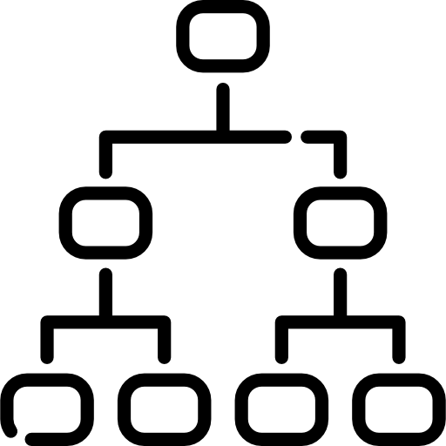


01
Flow Chart: Pre-Processing
10 Pages
Text Files
Searchable
Formats
LLM
OCR
Create
Picture
Memory Hierarchy
Tags

Slide 8

01
Flow Chart: Querying
Prompt
User
LLM

Slide 9
01
Flow Chart: Querying
Prompt
User
LLM
Tags

Slide 10
01
Flow Chart: Querying
Prompt
User
LLM
Tags
Hierarchy

Slide 11

01
Flow Chart: Querying
Prompt
User
LLM
Search Results
Tags
Hierarchy

Slide 12


01
Flow Chart: Querying
Prompt
User
LLM
Answer
Search Results
Tags
Hierarchy

Slide 13

01
Resource Needed
Token
Model: Any
Amount: 10M
Disk Space
1T storage (for user data files)

Slide 14
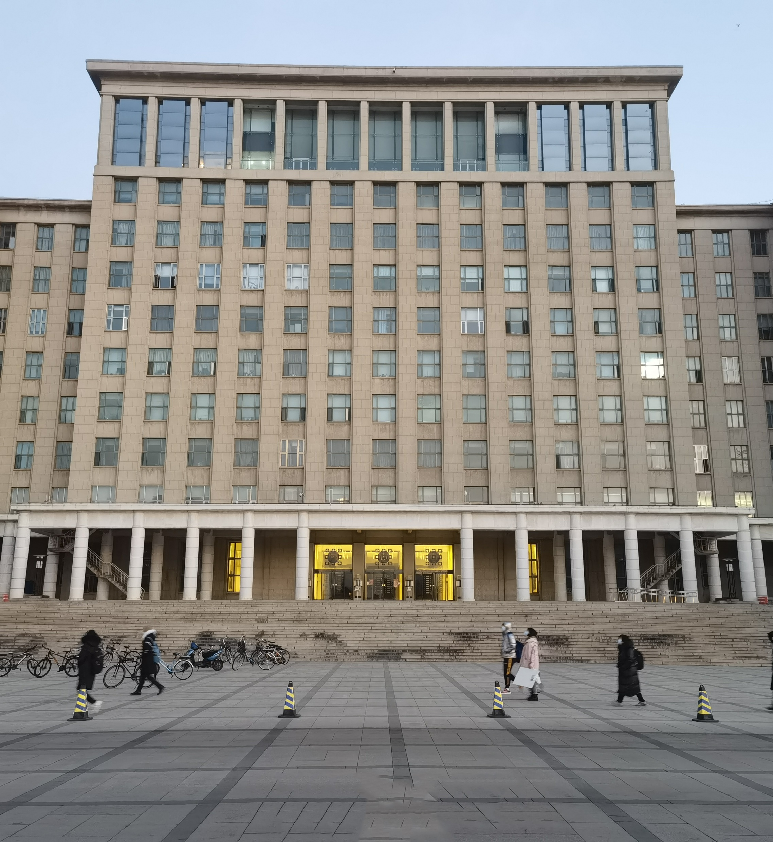


TSINGHUA UNIVERSITY
Q & A

Slide 15

TSINGHUA UNIVERSITY
Thanks!

